Slide 1

ECE 281 Lesson 16
Maj Jeffrey Falkinburg USAFA/DFEC
Room 2E46E 333-9193
1

Slide 2
Lesson 16 Outline
Do Time Logs!
Homework #2 (LSN 15/16 Worksheet) Due LSN 17 (next time)
Lab #2 Prelab Due LSN 19
Finite State Machines – FSMs
FSM Analysis

Slide 3
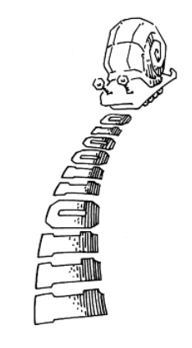
In-Class Exercise
Draw me a picture of a Mealy or Moore State Transition Diagram that shows
A Snail is crawling across a sequence of numbers and he smiles if the last 2 numbers are “11”
Sequence: 0100110111

Slide 4
In-Class Exercise – One Moore Solution
A Snail is crawling across a sequence of numbers and he smiles if the last 2 numbers are “11”
Sequence: 0100110111
N=0
N=1
reset
S0
☺=0
S1
☺=0
N=0
N=1
N=0
S3
☺=1
N=1

Slide 5
Homework – Review Book Example
Take a look at how the book implements “01”
Example 3.7 on p 132
A Snail is crawling across a sequence of numbers and he smiles if the last 2 numbers are “01”
Sequence: 0100110111

Slide 6
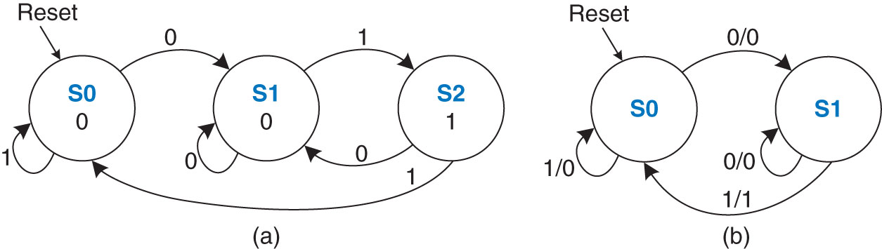
Homework – Review Book Example
Example 3.7 on p 132
A Snail is crawling across a sequence of numbers and he smiles if the last 2 numbers are “01”
Sequence: 0100110111
Figure 3.30 FSM state transition diagrams: (a) Moore machine, (b) Mealy machine
Copyright © 2013 Elsevier Inc. All rights reserved.

Slide 7
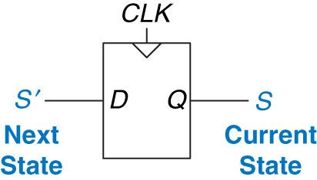
Flip-Flops
From last time: What do F/Fs create?
Memory!
When do F/Fs this?
Clock Edge!
Figure 3.20 Flip-flop current state and next state
Copyright © 2013 Elsevier Inc. All rights reserved.

Slide 8
Finite State Machines – Design/Analysis
State Machines:
0) Description
1) State Transition Diagram
2) State Transition Table & Output Table
3) Next State and Output State Equations
4) Schematic
Design
Analysis
Copyright © 2013 Elsevier Inc. All rights reserved.

Slide 9
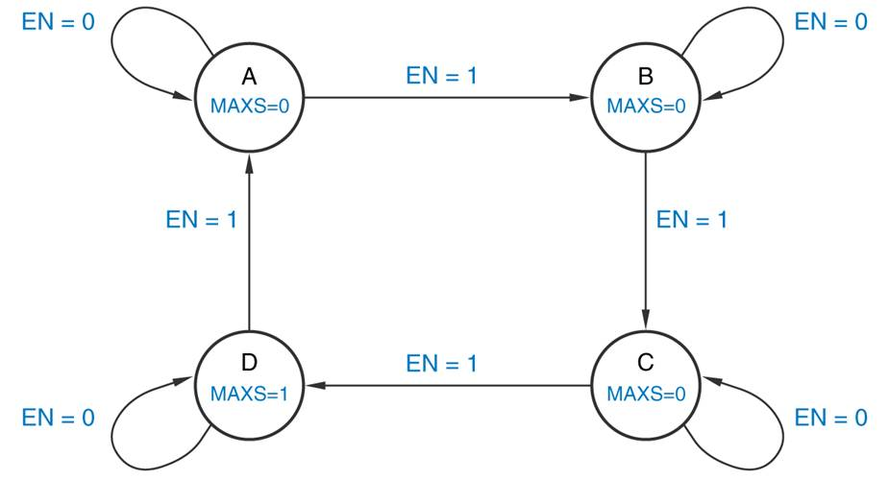
Question 1
True/False The state transition diagram below represents a Moore machine.

Slide 10
Finite State Machines - Moore vs Mealy Machine
Moore Machine – outputs depend only on current state of the machine.
Mealy Machine – outputs depend on both the current state and current inputs of the machine.
Clock
Next
State
Current
State
Inputs
M
Combinational Logic or
Next State Logic
K
Flip Flops
K
Output Logic
N
Outputs
Clock
Next
State
Current
State
Inputs
M
Combinational Logic or
Next State Logic
K
Flip Flops
K
Output Logic
N
Outputs

Slide 11
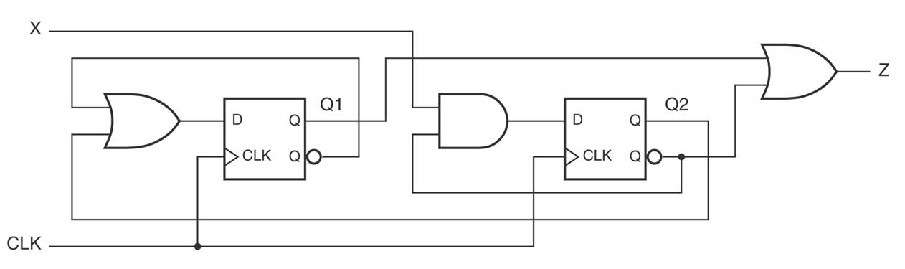
Questions 2 & 3
Is the finite state machine below a Mealy or Moore machine?
What is the next state equation for D1?
D1
D2

Slide 12
Question 4
For the finite state machine below, if the state machine is in state S2 and the input EN is a '1' when the clock transitions from low to high, what will be the machine's next state and output?
Current State S | Input EN | Next State S’ | Output Y
S0 | 0 | S0 | 0
S0 | 1 | S1 | 0
S1 | 0 | S0 | 1
S1 | 1 | S2 | 1
S2 | 0 | S3 | 1
S2 | 1 | S2 | 0
S3 | 0 | S0 | 0
S3 | 1 | S1 | 1

Slide 13
Questions 5 & 6 & 7
True/False The steps for designing a clocked synchronous state machine, starting from a word description, are just about the reverse of the analysis steps.
If a state machine requires 5 states to implement the problem, how many D flip-flops are needed (assume binary encoding)?
If a state machine requires 5 states to implement the problem, how many total states will exist in the final circuit?

Slide 14
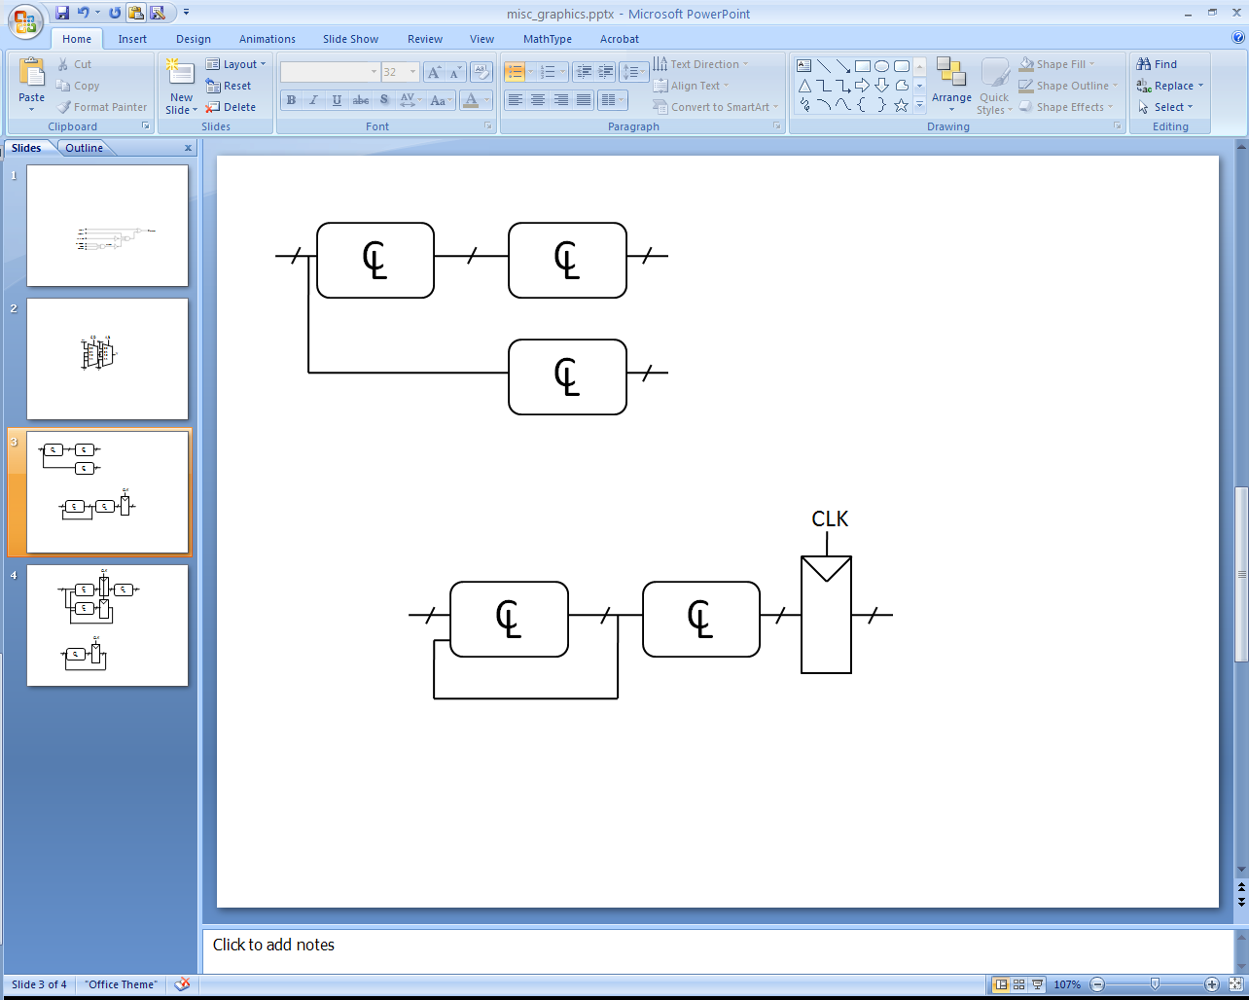
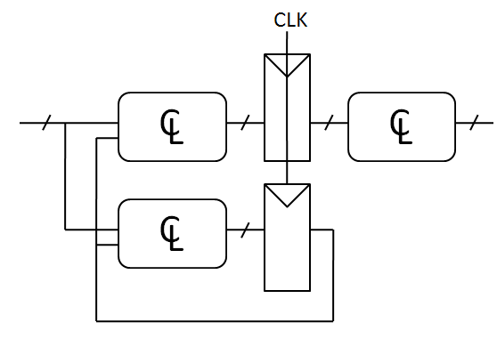
Question 8
Which of these circuits is a valid synchronous sequential circuit?
Synchronous Sequential Circuit Properties:
Each element is either a register or a combinational circuit
At least one circuit is a register
All registers have the same clock
Every cyclic path contains at least one register

Slide 15
Question 9
During sequential circuit design, which combinational logic tool is commonly used to derive next state equations from their associated next state table?
Boolean algebra
Two-hot assignment
Karnaugh maps

Slide 16
Question 10
State machine analysis is a process that begins with a circuit schematic and results in a state transition diagram. If given a schematic, the first step in analysis would be:
Determine the logic elements required to build the state machine
Determine the next-state and output functions implemented by the circuit
Predict the next state that the circuit will transition to

Slide 17
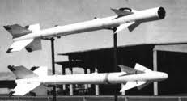

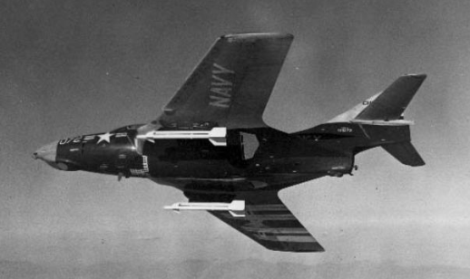
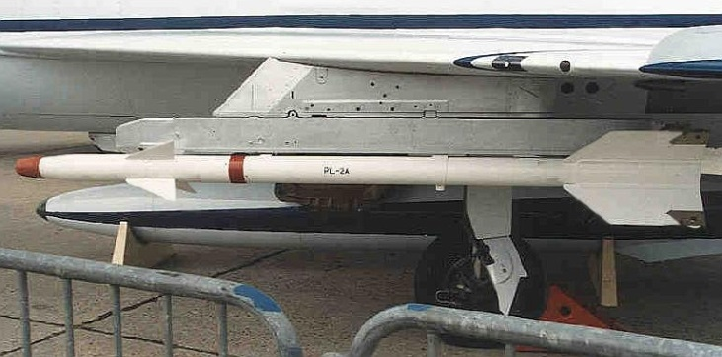

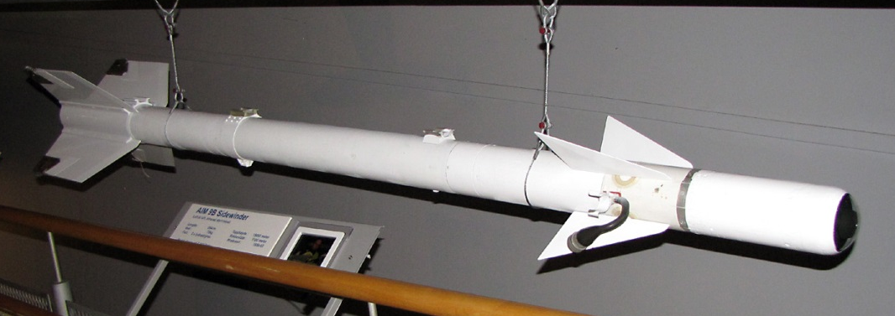
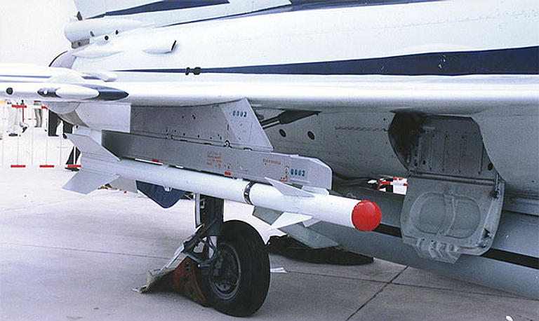
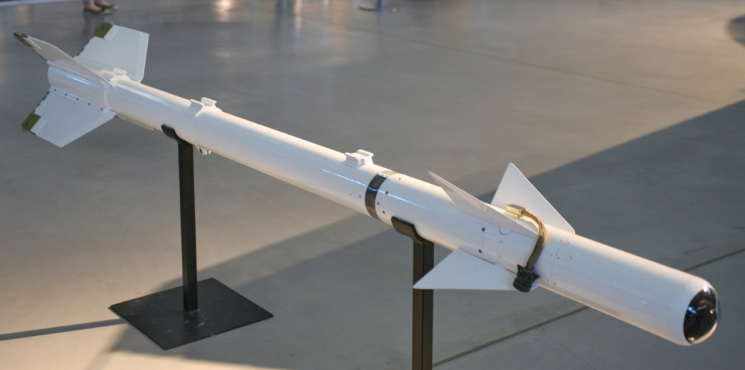
AIM-9B AA-2 (K-13)

Slide 18
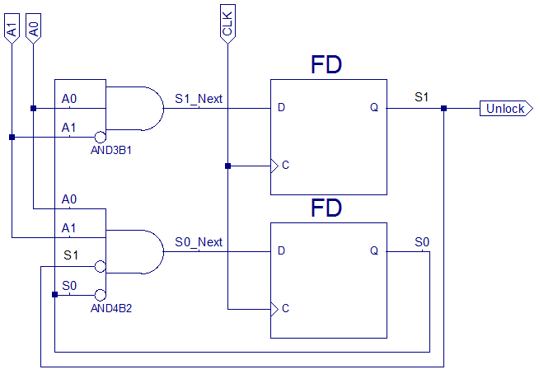
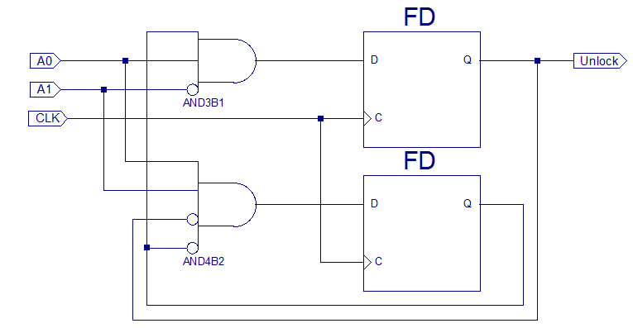
Finite State Machines - Analysis
Joe Homeowner’s Gargage Door Opener…we are given the schematic
S0
A0
S1*
S1
MSB
A1
CLK
A0
A1
S0*
S0
S1
LSB
S0
CLK
Copyright © 2013 Elsevier Inc. All rights reserved.

Slide 19
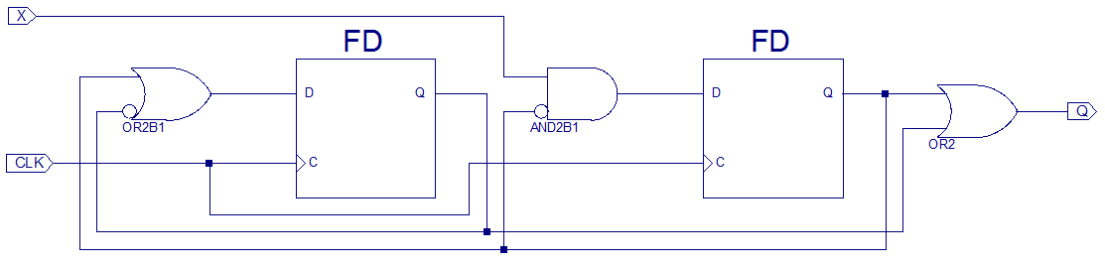
Another Analysis Example
HW 3.31 – Write the next state/output tables and equations. Draw the state transition diagram.
S1*
S1
S0*
S0
MSB
LSB

Slide 20
Divide-by-N Counter – Example 3.6
Has one output and no inputs
The output Y is HIGH for one clock cycle out of every N
In other words, the output divides the frequency of the clock by N

Slide 21
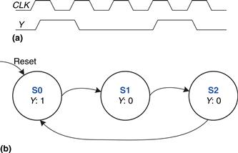
Divide-by-3 Counter – Example 3.6
The waveform and state transition diagram for a divide-by-3 counter is shown in Figure 3.28
Next State Table
Current State | Next State
S0 | S1
S1 | S2
S2 | S0
Output Table
Current State | Output
S0 | 1
S1 | 0
S2 | 0

Slide 22
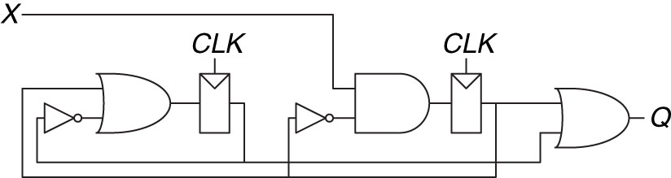
Another Analysis Example
HW 3.31 – Write the next state/output tables and equations. Draw the state transition diagram.
S1*
S1
S0*
S0

Slide 23
Extra Instruction (EI)
Maj Jeffrey Falkinburg
2E46E
Office: 333-9193
M1
ECE 281 – 2F44
T1
M2
ECE 281 – 2F44
T2
M3
ECE 463 – 2G2
T3
ECE 383 – 2E48A
M4
ECE 463 – 2G2
T4
ECE 383 – 2E48A
Available
M5
T5
Sometimes Available
M6
ECE 383 – 2E48A
T6
Always Unavailable
M7
ECE 383 – 2E48A
T7

Slide 24

24

